Slide 1
Dataflow Debug & optimization
111061551 宋乃仁

Slide 2
Outline
Dataflow Viewer
Goal
Code & Dataflow Graph
Dataflow Properties Table
Dataflow Performance Waveform
Conclusion
FIFO Sizing & Deadlocks
Introduction

Slide 3
Dataflow viewer - Goal
The optimization is done in two parts：
first, the compiler infers the parallel tasks and sets up the communication channels and the associated control
second, after the generated RTL design is simulated, the performance of the DATAFLOW optimization can be analyzed
the Dataflow viewer help us see the dataflow structure inferred by the tool, inspect the channels (FIFO/PIPO), and examine the effect of channel depth on performance.
Vitis HLS GUI

Slide 4
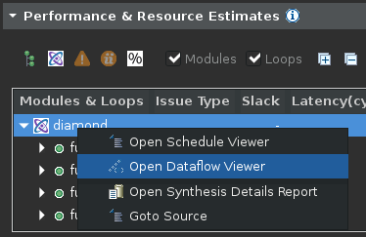
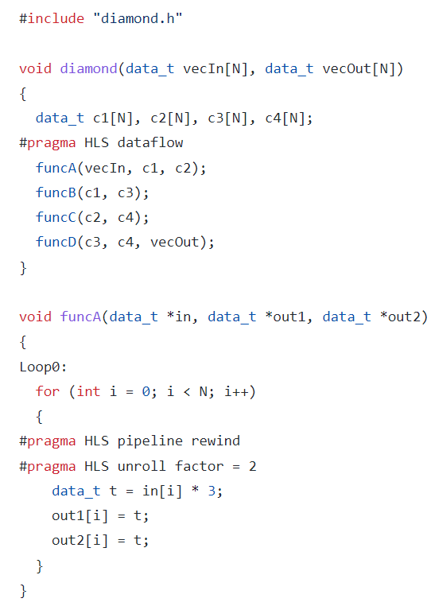
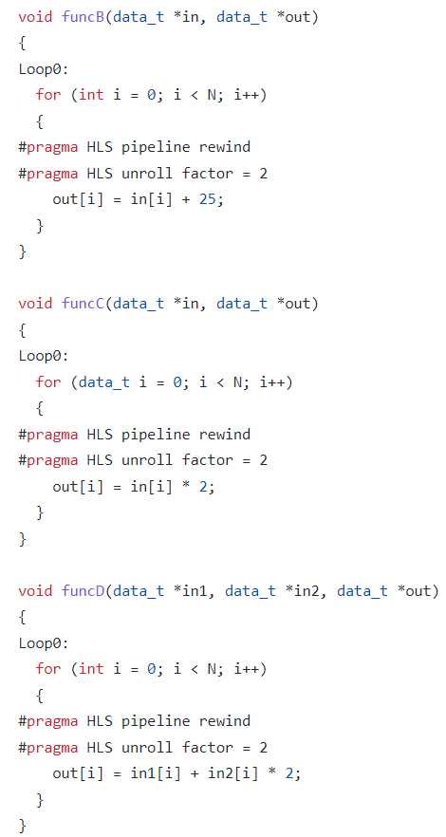
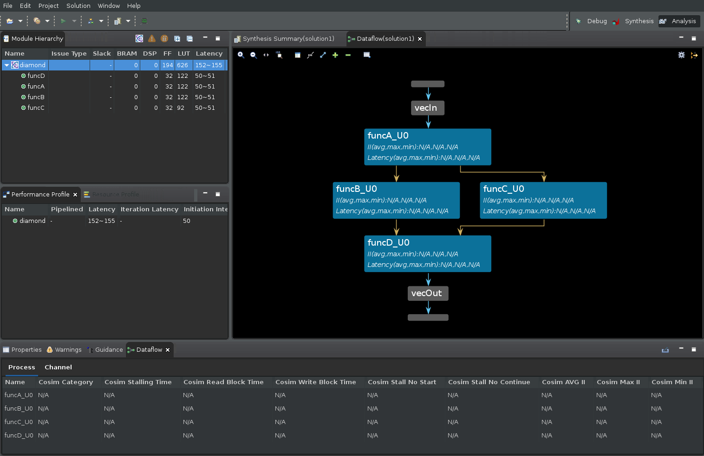
Dataflow viewer - Code & Dataflow Graph

Slide 5
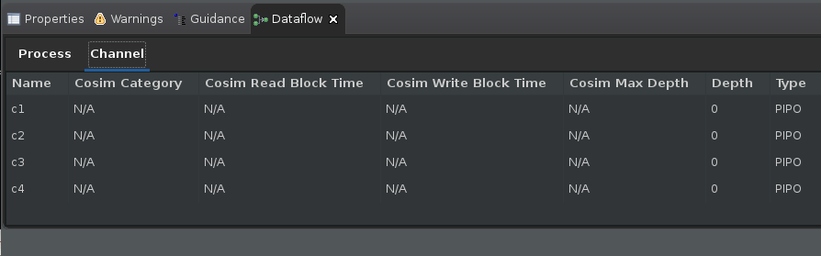
Dataflow viewer - Dataflow Properties table
Dynamic optimization
The effects of the optimization cannot be seen until after running RTL co-simulation.

Slide 6
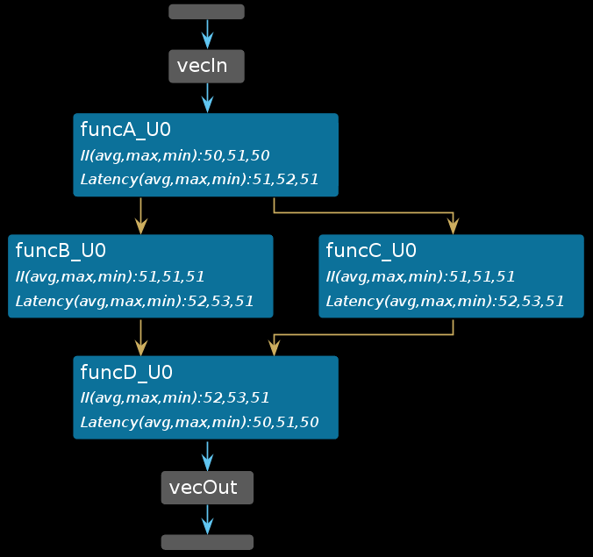
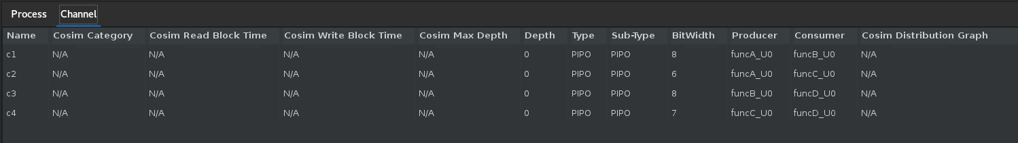
Dataflow viewer - Dataflow Properties table
After Co-simulation
We can inspect the details of each sub-function in the hierarchy such as latency, II, and logic resource estimates.

Slide 7
Dataflow viewer - Dataflow Properties table
Cosim Stalling Time column indicates what percentage of the simulation time was spent stalling for this particular process.
Cosim Read Block Time or Cosim Write Block Time shows the percentage of time blocked from reading or writing to the process's channels.
Cosim Stall No Start and Cosim Stall No Continue indicates forward and back pressure respectively

Slide 8
Dataflow viewer - Dataflow Properties table
The channel table also shows the depth (Depth), type of channel (Type) and the maximum depth achieved during the simulation (Cosim Max Depth) by the channel.
These data fields are useful for FIFO channels.
Cosim Category has four possible self-explanatory states: "none", "read_block", "write_block" and "read_block and write_block".

Slide 9
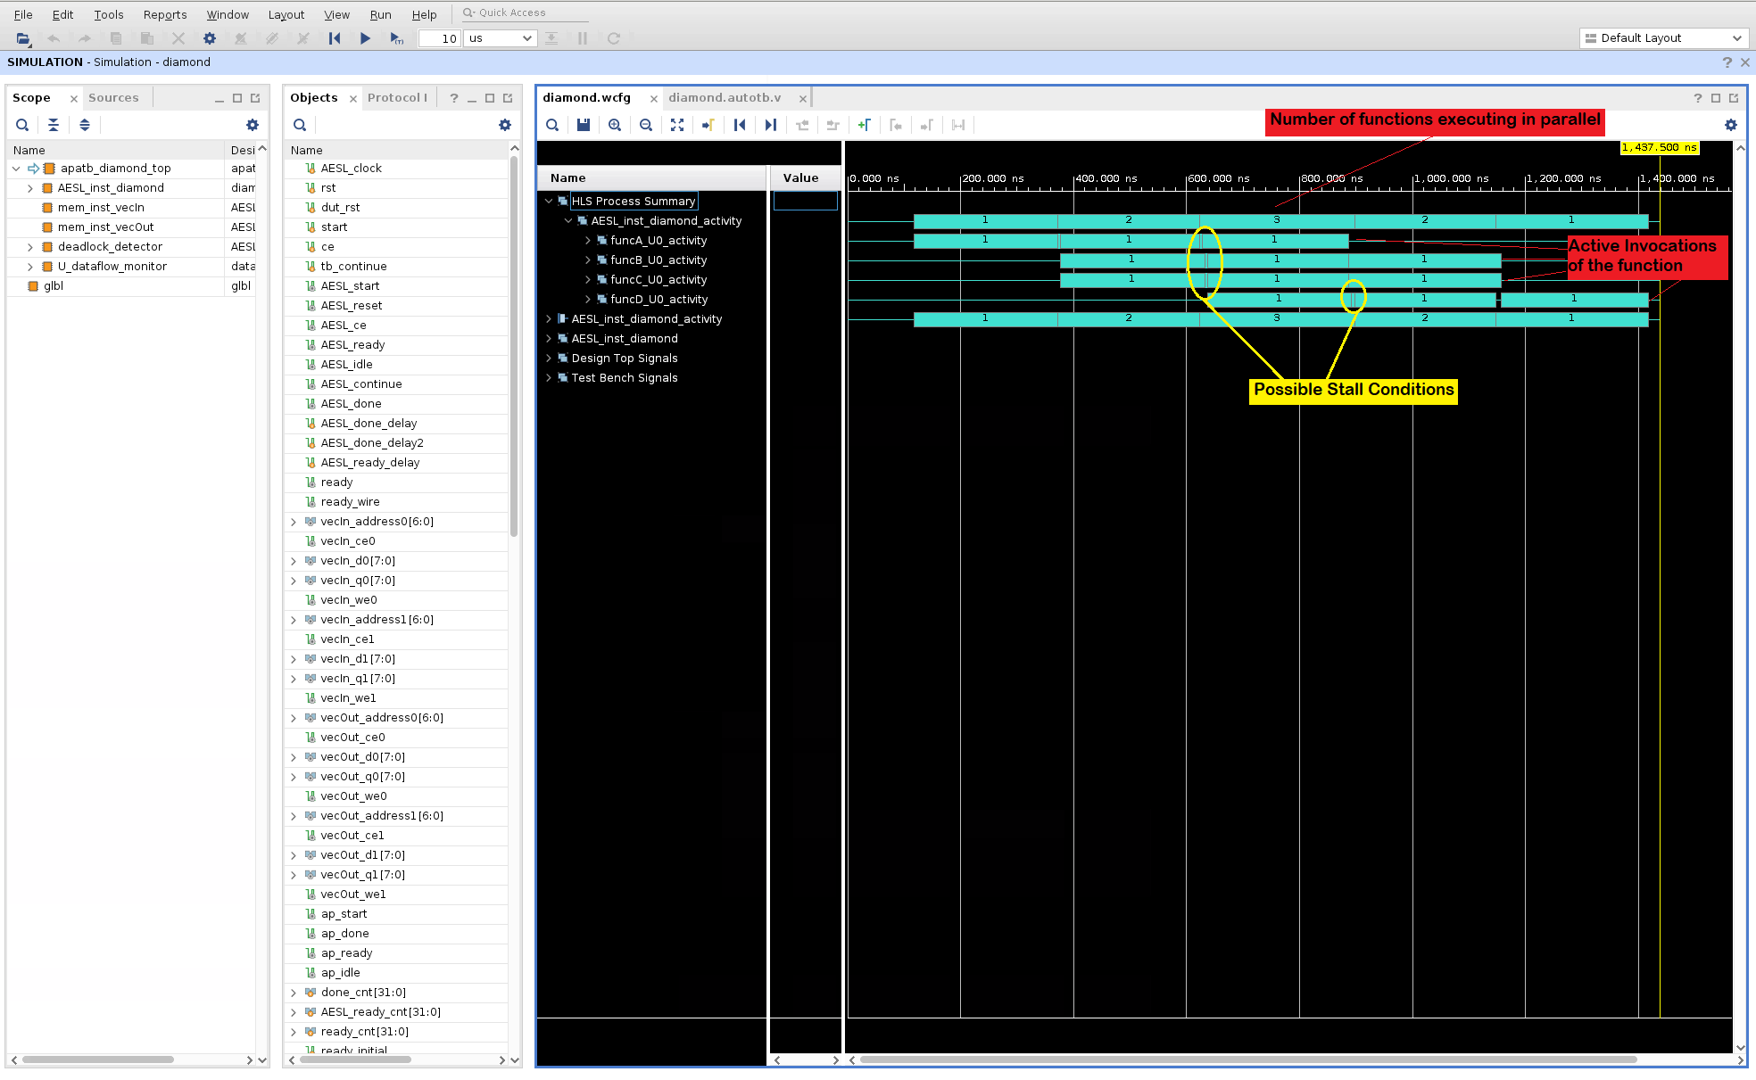
Dataflow viewer - Dataflow Performance waveforms

Slide 10
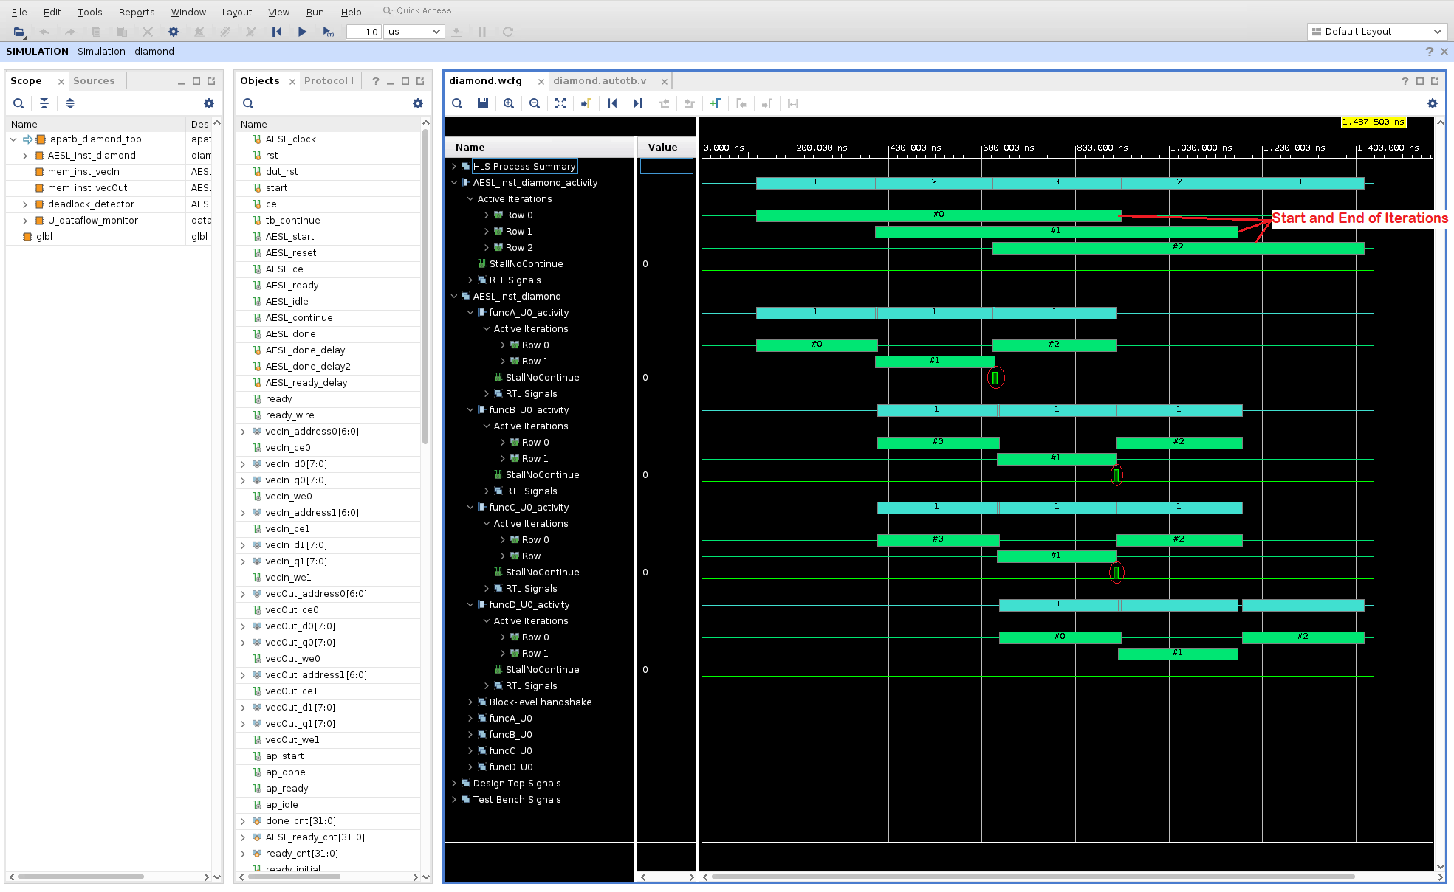
Dataflow viewer - Dataflow Performance waveforms

Slide 11
Dataflow viewer - Conclusion
From the property tables, there are important indicators that point out potential problems inside the dataflow region and are indicative of the typical producer-consumer rate issues that can result in lower performance and/or in some cases, deadlock.
Since the Dataflow Viewer can only show us the static view of the dataflow optimization. From the performance waveform, we can see how the functions inside the dataflow region are executed in parallel and how the execution of the functions overlap. We realize the visualization of dynamic timeline .

Slide 12

FIFO Sizing & Deadlocks - Introduction
For exactly the same structure of code, depending on how the FIFO channels are accessed, the FIFO depths may need to be set differently.
FIFO depths are used to amortize and match the burst behavior of FIFO accesses.

Slide 13
FIFO Sizing & Deadlocks - Introduction
Compiler-created FIFOs and PIPOs should never cause deadlocks. But their depths might be insufficient for optimal performance.
User created FIFOs (from hls::streams and hls::stream_of_blocks between processes) may cause both deadlocks and/or low performance depending on their depths.
If the depth of FIFOs or PIPOs is too small, they can become full.
This issue can be fixed by increasing the depth of the channel. There are three ways to do this FIFO sizing:
Manual FIFO sizing
Global FIFO sizing
Automated FIFO sizing

Slide 14
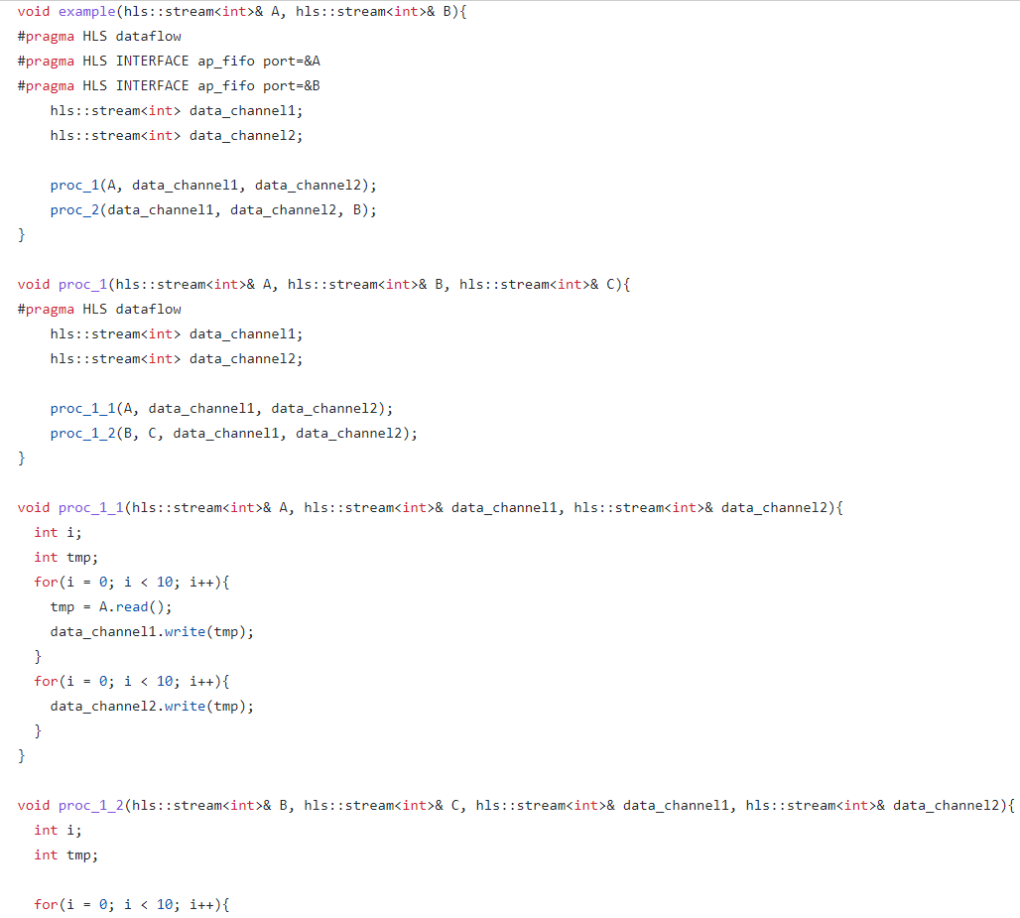
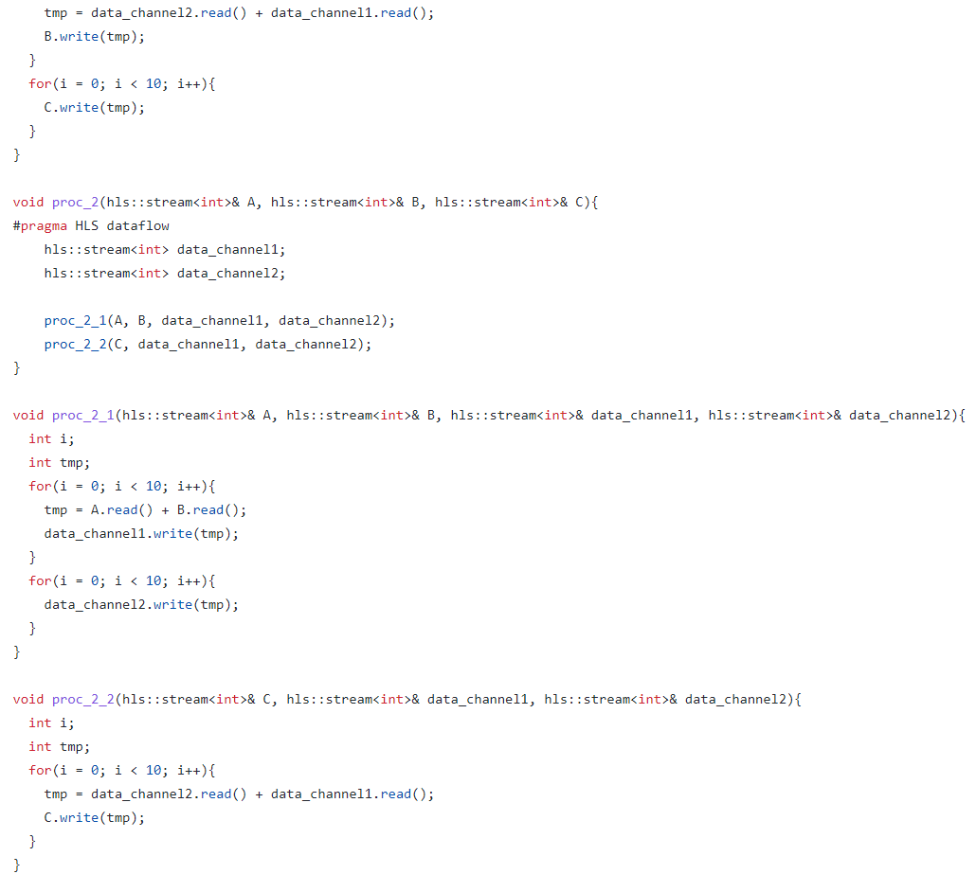
FIFO Sizing & Deadlocks - Code

Slide 15
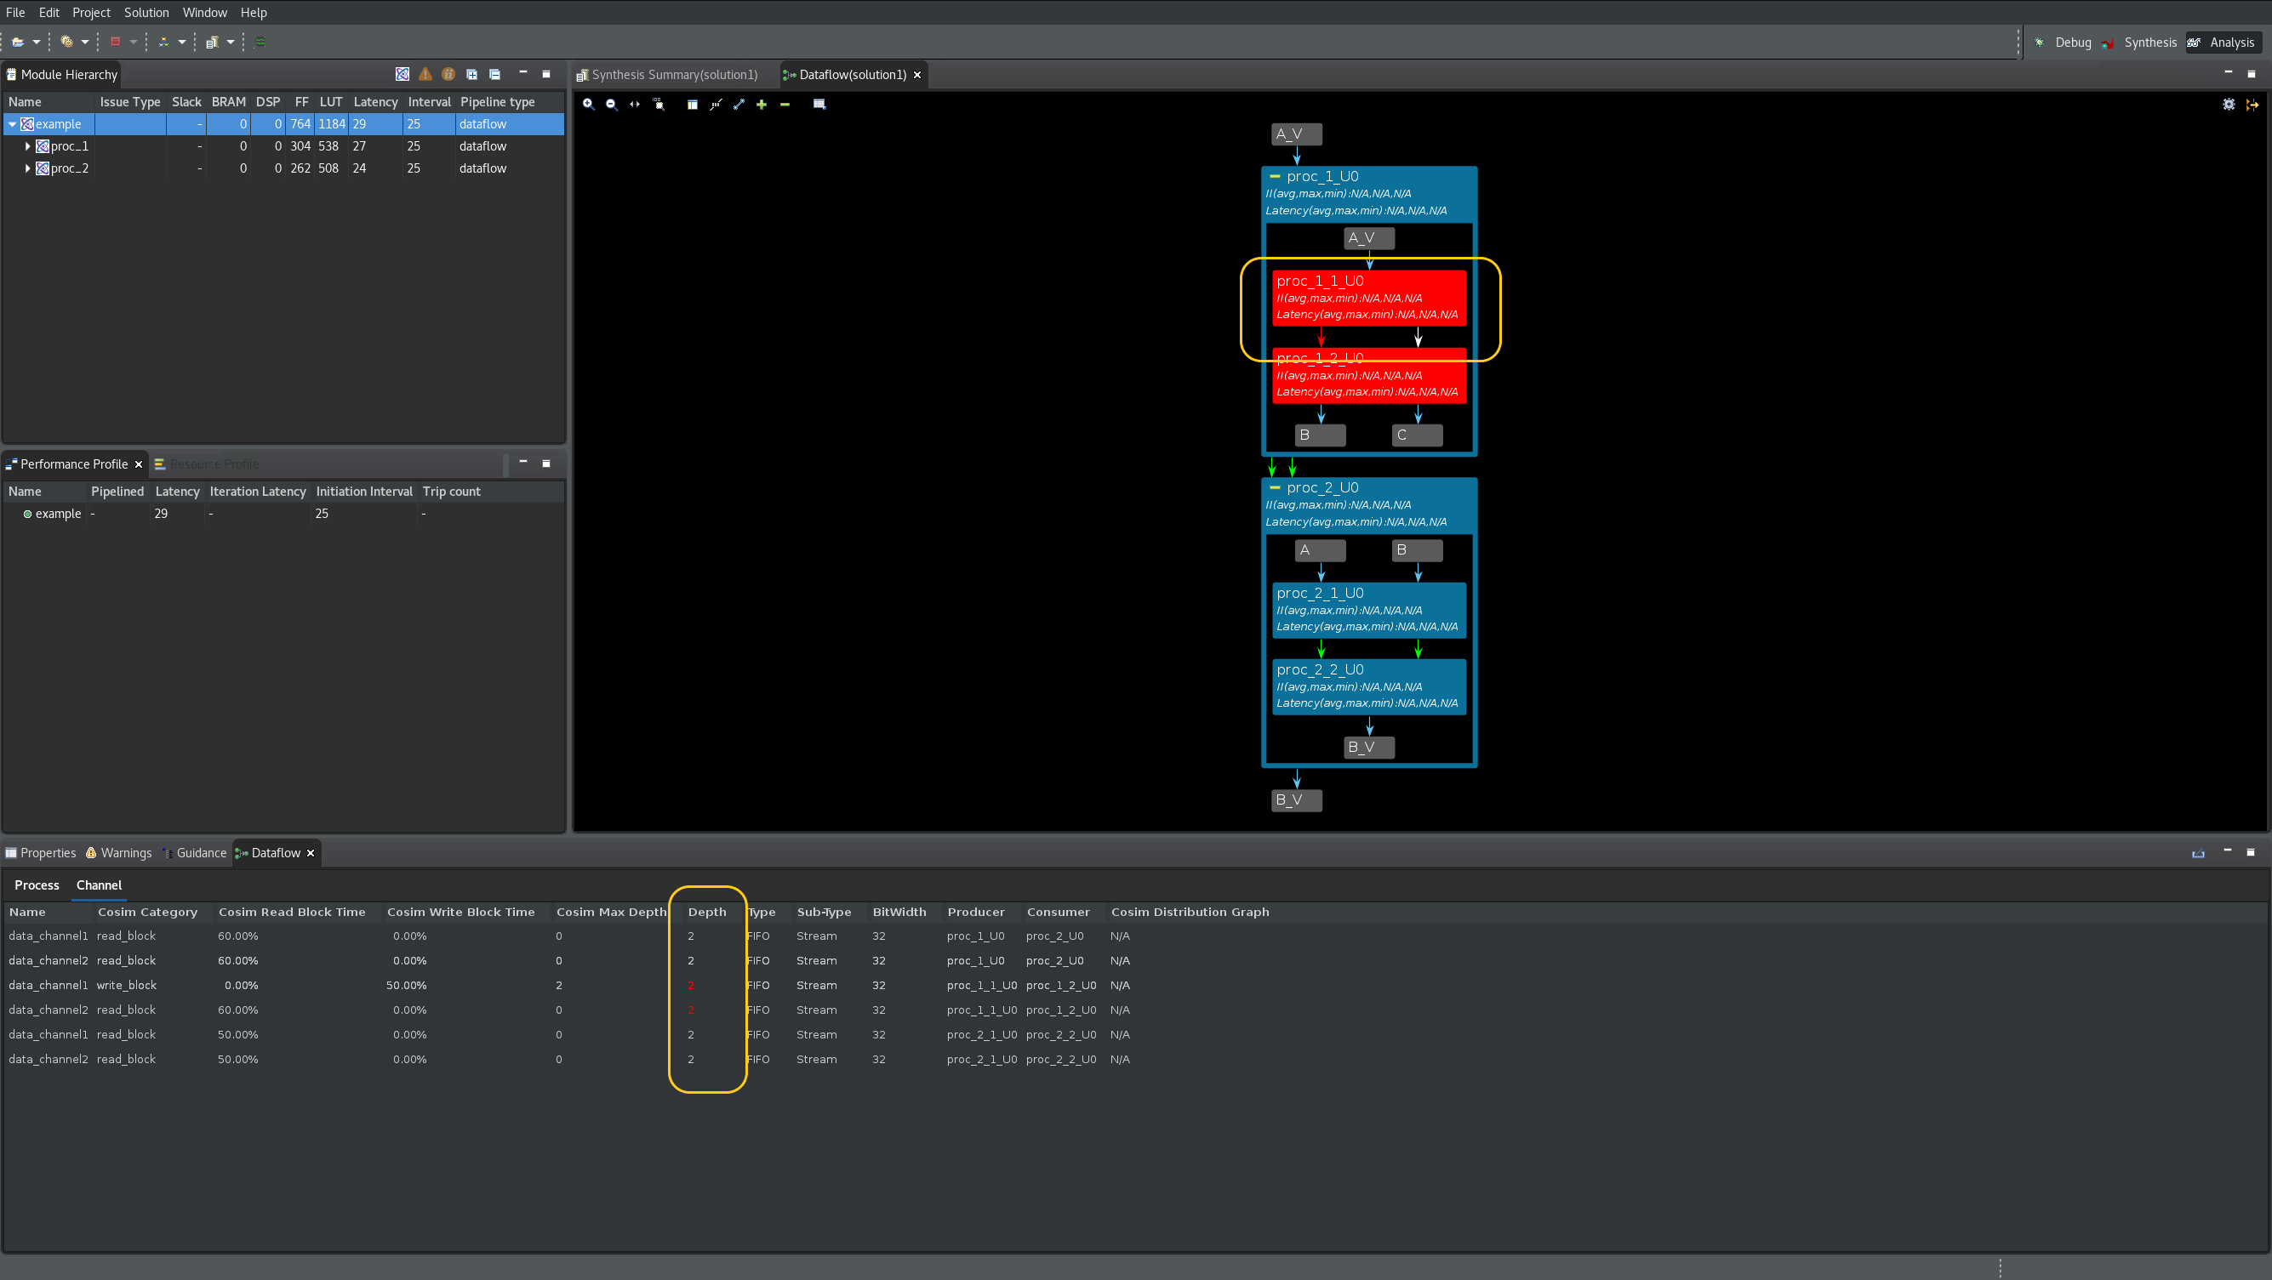
FIFO Sizing & Deadlocks - Manual FIFO Sizing

Slide 16
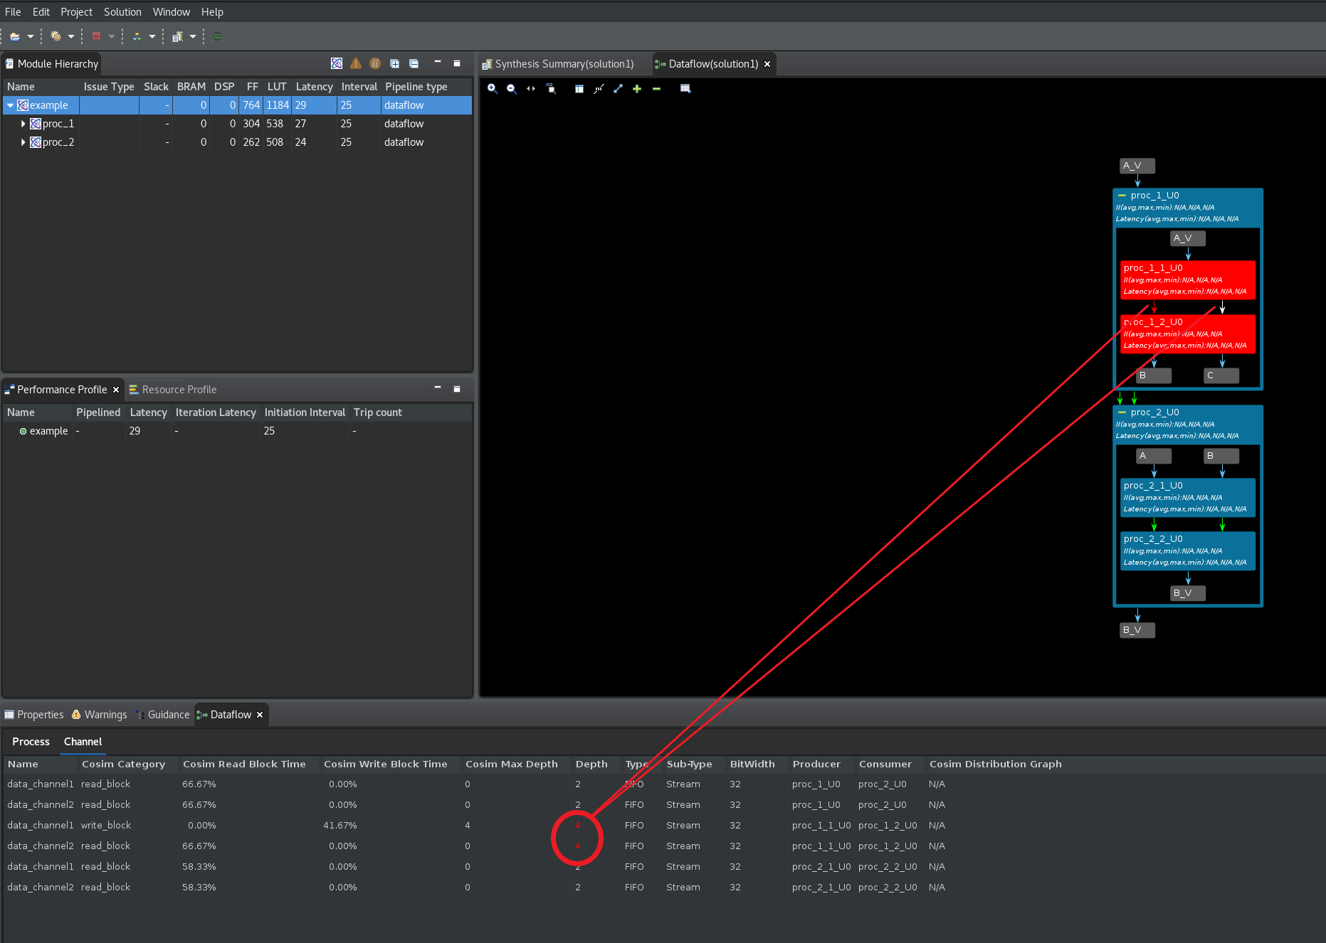
FIFO Sizing & Deadlocks - Manual FIFO Sizing

Slide 17
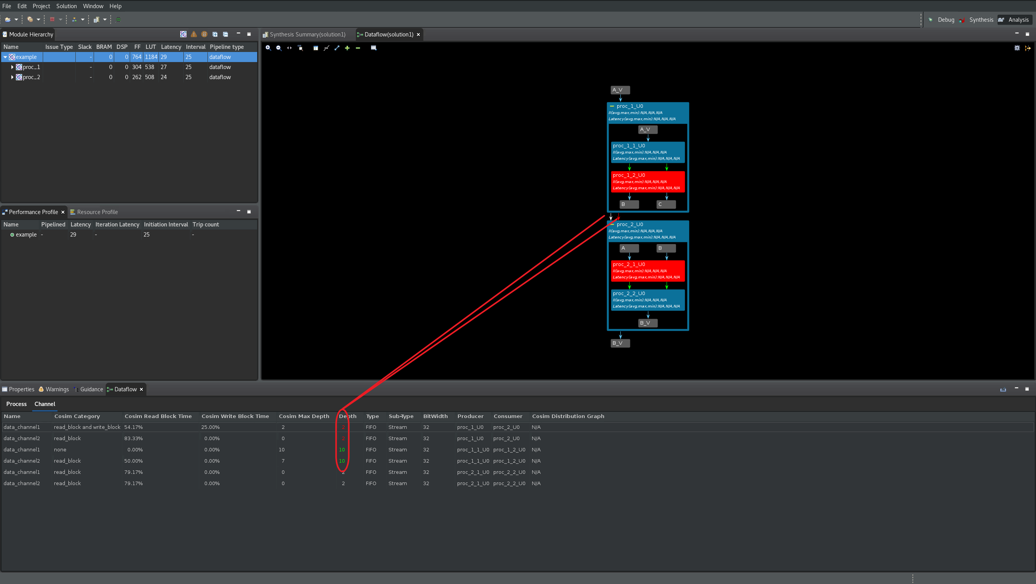
FIFO Sizing & Deadlocks - Manual FIFO Sizing

Slide 18
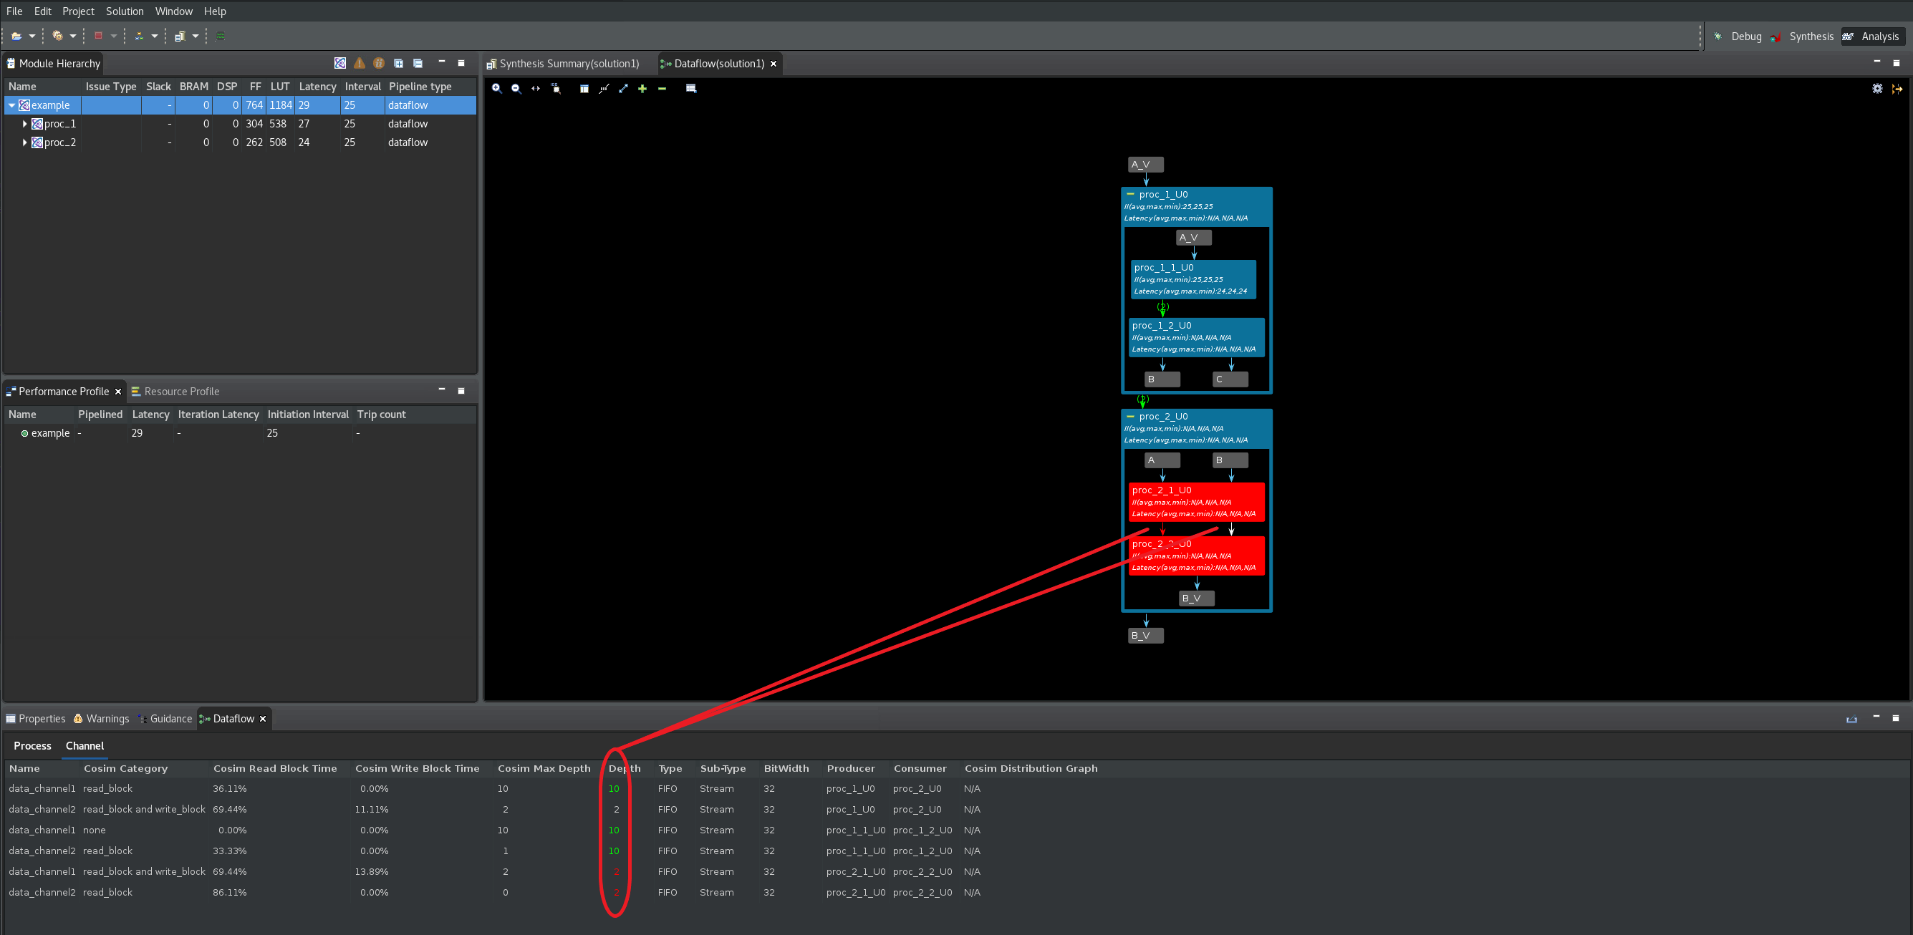
FIFO Sizing & Deadlocks - Manual FIFO Sizing

Slide 19
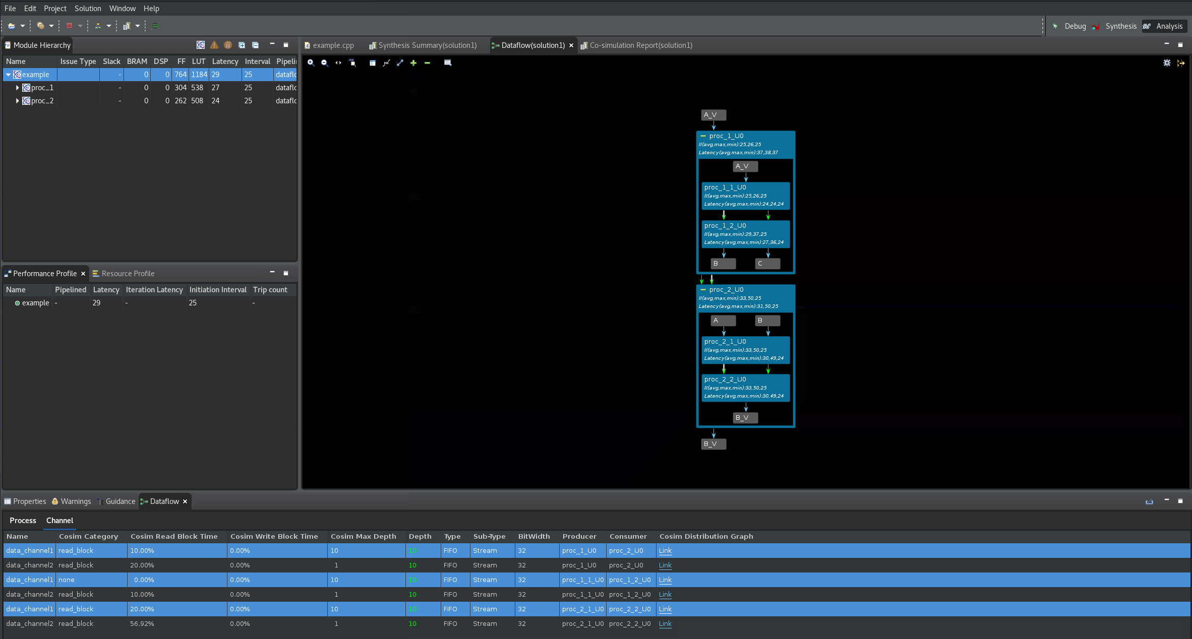
FIFO Sizing & Deadlocks - Manual FIFO Sizing

Slide 20
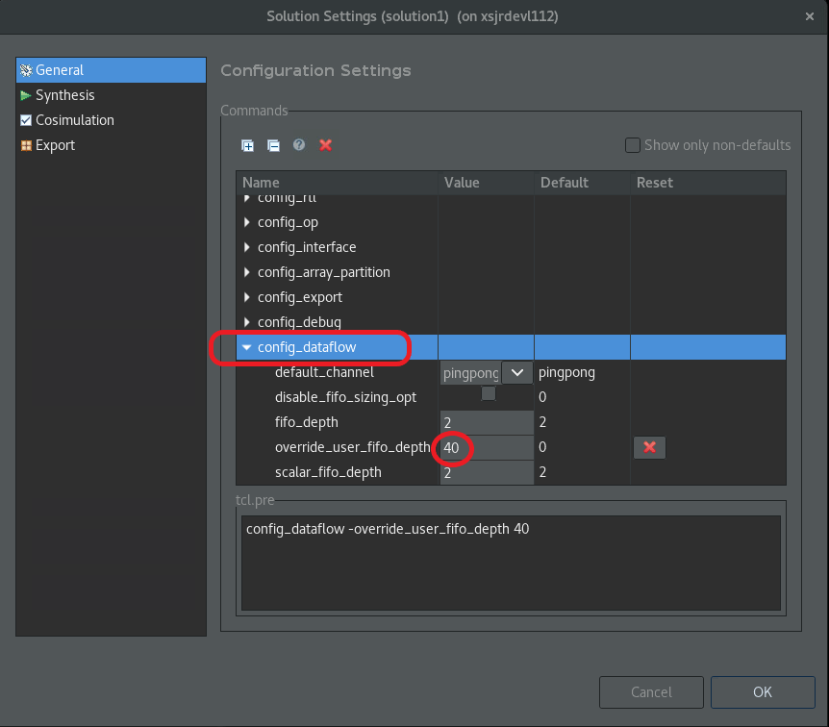
FIFO Sizing & Deadlocks - Global FIFO Sizing

Slide 21
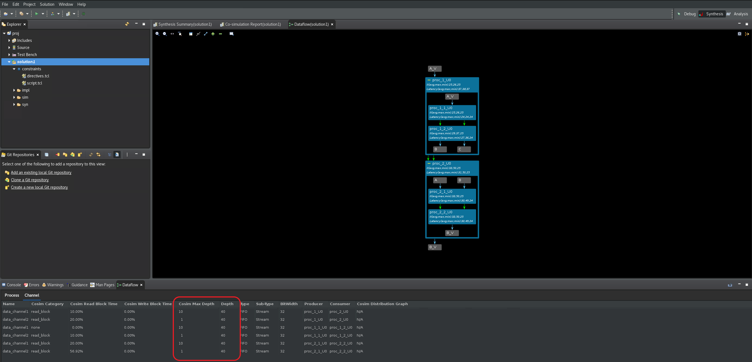
FIFO Sizing & Deadlocks - Global FIFO Sizing

Slide 22
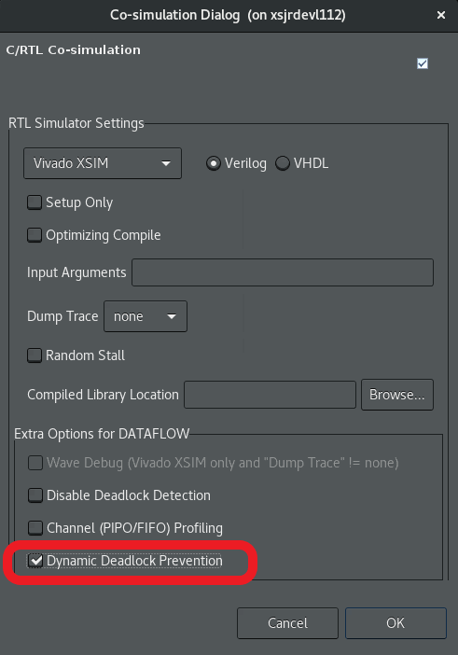
FIFO Sizing & Deadlocks - Automated FIFO Sizing
The automatic FIFO sizing is the easiest but there are disadvantages:
It requires repeated co-simulation runs and so may take a while to converge.
It is a heuristic algorithm, and in some cases it may never converge.

Slide 23
FIFO Sizing & Deadlocks - Conclusion
In summary, the Dataflow viewer enables the following throughput analysis tasks:
The graph shows the overall topology of the DATAFLOW region and shows what type of channels (FIFO/PIPO) were inferred for communication between the tasks in the DATAFLOW region. Analyzing each channel and process can be useful to resolve issues such as deadlock or poor throughput because of bad FIFO sizing.
The co-simulation data helps with the FIFO sizing problem by tracking the maximum size of the FIFO during the course of the simulation and thereby giving the user a good reference point on how to size the FIFOs. In addition, when running co-simulation, automatic deadlock detection can highlight the processes and channels involved in the deadlock allowing the user to quickly narrow the focus and fix the issue.
In addition to FIFO sizing, the data reported after co-simulation also provides, on a per process and channel basis, the time spent stalling either waiting for input or blocked from writing output. The graph helps the user understand such issues and manage how the channels are sized to accommodate slow producers versus fast consumers and/or vice-versa. In addition, the graph is useful in understanding how reading from the input in the middle of a DATAFLOW region can impact performance. This is a fairly common scenario where performance can be impacted.

Slide 24
Thank you for listening!

